Slide 1
THE BATTLE OVER HISTORY
BQ4 Perspectives Lesson 8
I can explain why the statement ‘history is written by the victors’ is flawed
Notes:
See how this lesson links to the course by viewing the final slide
Key TOK terms appear in a red font

Slide 2
Starter
“History is written by the victors” (Winston Churchill)
What do you think Churchill meant? What does this suggest about the nature of historical knowledge?
Notes:
We’ll be examining this statement throughout the lesson and coming to the conclusion it’s incomplete or inaccurate.
For now, though, it’s enough for students to offer that those who win conflicts have more ability to write the record about what happened, and that the nature of historical knowledge is malleable and can be presented differently according the perspective of the person who writes it.
This useful blog post provides more info on what we’ll be looking at during this lesson.

Slide 3
Write down...
…anything and everything you know about the American Civil War

Slide 4
1: Fought between the Northern and Southern states from 1861-1865.
2: Abraham Lincoln was the President of the USA during the Civil War.
3. Lincoln’s anti-slavery stance caused several southern states to ‘secede’ after he was elected president.
4 The North had more men and war materials.
5: The North won the Civil War.
6: After the the war, the Constitution was amended to free slaves, give “equal protection under the law” to citizens, and grant black men the right to vote.
Notes:
Taken from https://www.battlefields.org/learn/articles/10-facts-what-everyone-should-know-about-civil-war

Slide 5
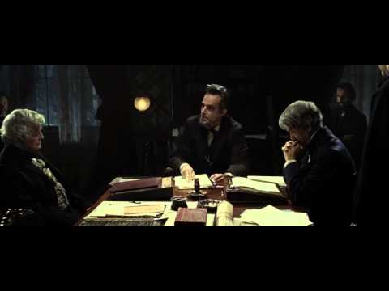
The USA, 1860
Watch the clip from ‘Lincoln’ (Spielberg, 2012).
What is the issue that Lincoln (played by Daniel Day Lewis) is so keen to resolve?
Notes:
Video link also found here.
Maybe worth of discussion - can we use fictional movies to gain knowledge about the past…?

Slide 6
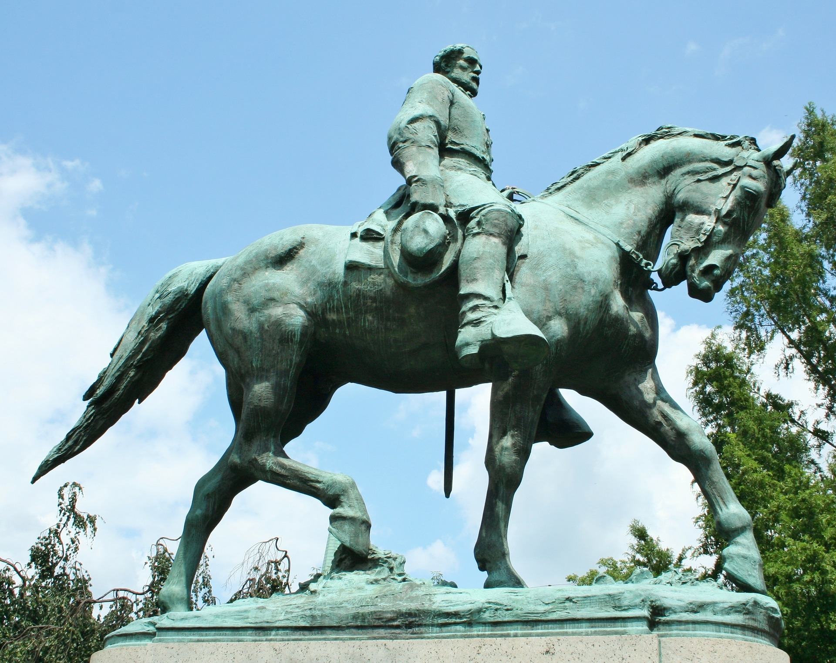
The USA, present day
Watch the clip from this news story.
What’s going on in the USA?
Notes:
Link also here.
Students will probably need a bit of background information to make full sense of this.

Slide 7
The ‘Lost Cause’
Explain how the following relate to the rewriting of American history:
The Lost Cause
United Daughters of the Confederacy
Unjust to the South & Northern Influence
Children of the Confederacy
Segregationism in the ‘50s and ‘60s
“Remembering our history”
Notes:
VIdeo link also here.
Lost Cause - “ the glorification of Confederate soldiers who died for a cause they believed in, the belief that slavery was a benevolent institution, and, maybe most importantly, that slavery was not the root cause of the war.”
United Daughters of the Confederacy. “They were the leaders of the Lost Cause into the 20th century, and they made it a movement about vindication.”

Slide 8
“Who wins the writing game, who wins the battle over history - ultimately wins the war”
(Kevin M. Levin)
How does this quote (from the video) differ from Churchill’s assertion (that “history is written by the victors”)?
Which of the two quotes do you find more helpful about history?
Notes:
History is often written with a self-aggrandising agenda (related to money and power!). This shapes how we present the past, which in turn can help determine the way the future progresses.
Students can draw on both local/regional and international examples of how people might seek to ‘rewrite’ history and help to promote their own positions.

Slide 9
Further examples
Choose another topic to research. Explain:
The group/individual that wanted to ‘rewrite history.’
Why they wanted to do this (what interest did it serve?)
What they hoped to achieve.
Notes:
This is an extra slide, and can be used to expand the lesson by 30 minutes or so (research + presentation of ideas + discussion).
Potential topics (should be posted on Google Classroom for students to choose, or be allocated) -
Korea decides to introduce a state-written history textbook in 2015, and the abandonment of this plan in 2017
The debate in Texas over how to cover certain aspects of the past in schools
Revisionist attitudes about the role of Gandhi in the independence of India
The 2017 French presidential candidates using the same issue from the past to promote different agendas

Slide 10
Links to the TOK exhibition
Related exhibition prompt How is current knowledge shaped by its historical development? (IAP-33)
Refer to the ideas from this lesson to answer this question.
For example, think about how our understanding of the past develops over time, and how what’s going on in the present often dictates the way we view history.
Which objects could help to illustrate your answer?
Notes:
Optional slide, if you want to help students to take ownership of the IA prompts (IAPs) for the TOK exhibition
For more ideas on relevant IAPs, see the ‘Linking this lesson to the course’ slide

Slide 11
“Study the historian before you study the facts” (EH Carr)
What did Carr mean?
To what extent does this answer the problems associated with history?
Can it be applied to other areas of knowledge?
Notes:
This is one of the most important quotes or ideas we ever look at!
Evaluating the person or group creating the knowledge is more important than evaluating the knowledge.
Yes, if applied properly, it solves all the problems.
Yes, it can be applied to ALL the areas of knowledge!
See the BQ4 assessment tracker for suggestions on providing feedback, and recording students’ progress

Slide 12
Linking this lesson to the course
During this lesson, we consider the highlighted aspects of the TOK course
The images used in the presentation slides can also give students ideas about selecting exhibition objects; see also our link below to specific IA prompts
CORE THEME | OPTIONAL THEMES | AREAS OF KNOWLEDGE | TOK ASSESSMENT
Knowledge & the knower | Indigenous societies | The arts | The TOK essay
 | Language | History
 | Politics | The human sciences | The TOK exhibition Could be linked to IAP-9 (interpretation), IAP-13 (improvement), IAP-15 (constraints), IAP-33 (development)
 | Religion | Mathematics
 | Technology | The natural sciences

Slide 13
Explore the TOK themes and areas of knowledge in more depth via a range of thinkers, media sources, and other resources, in our EXPLORATION POINTS DOCUMENTS.
Access the documents via the links below. You’ll also find the EP icons on all of the TOK course pages of the site to help you unpack the quotes, KQs, and real-life situations that you find there.
CORE THEME
Knowledge & the knower
OPTIONAL THEMES
Indigenous societies
Language
Politics
Religion
Technology
AREAS OF KNOWLEDGE
The arts
History
Human sciences
Mathematics
Natural sciences
Notes:
Use this slide to access the ‘Exploration Points’ notes for BQ4, which will help students to develop a deeper knowledge of any TOK theme or area of knowledge. This will not only help them to master the TOK course in general, but also craft a great exhibition or essay.
Be ready to provide more guidance on how to use this resource - ie, which media sources to focus on, which questions to address, which TED talks to watch, and which key terms and ideas to understand.

